Slide 1
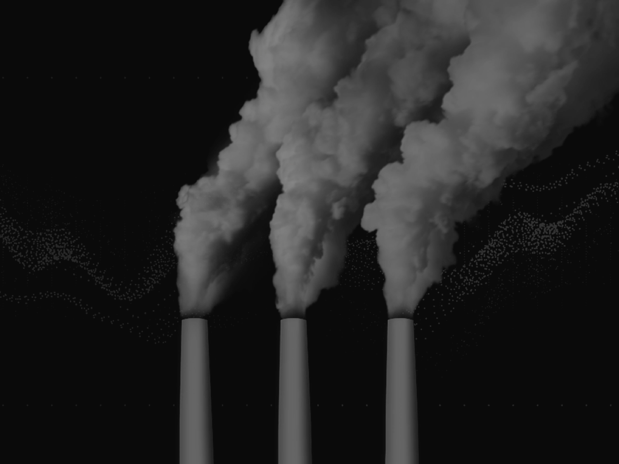
Reverse Combustion

Slide 2
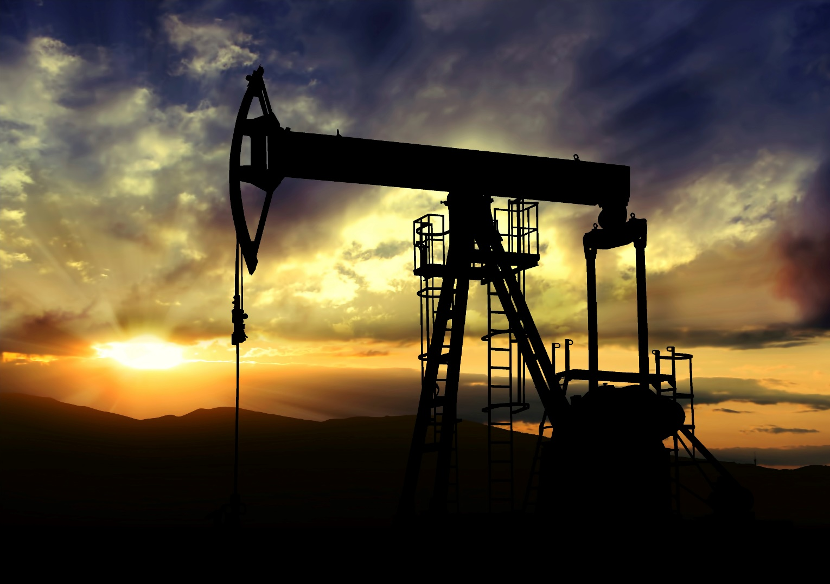

Slide 3
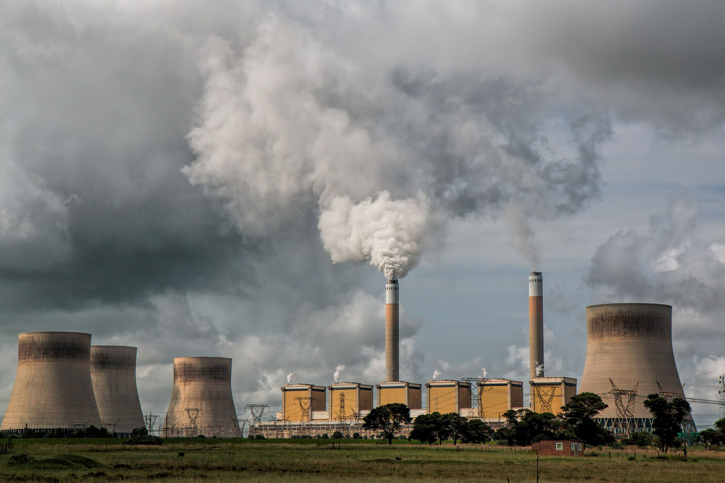

Slide 4
What if the story of waste CO₂ could be rewritten?

Slide 5
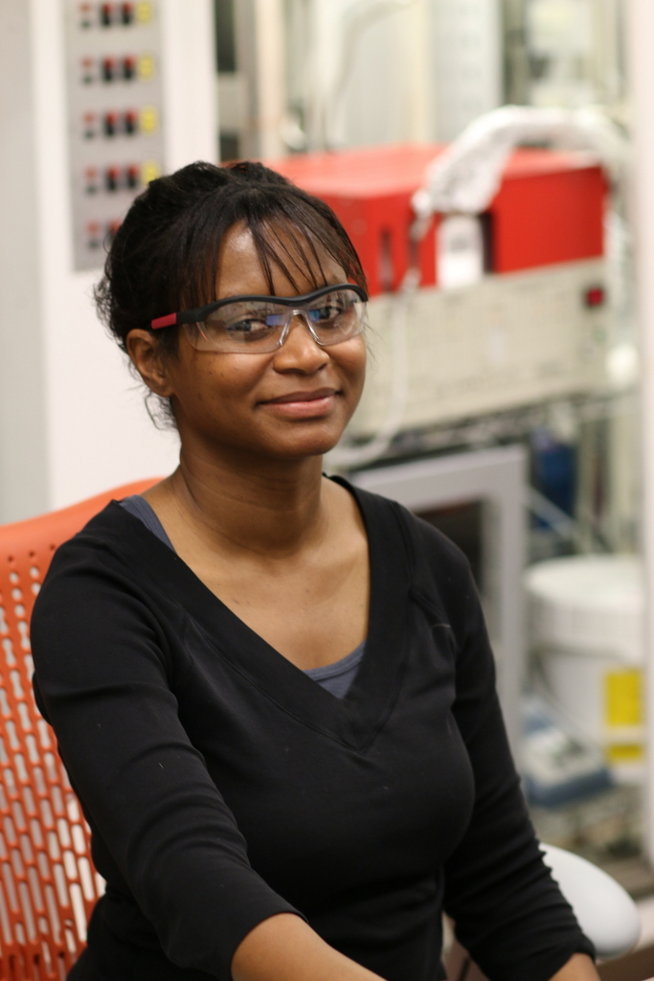
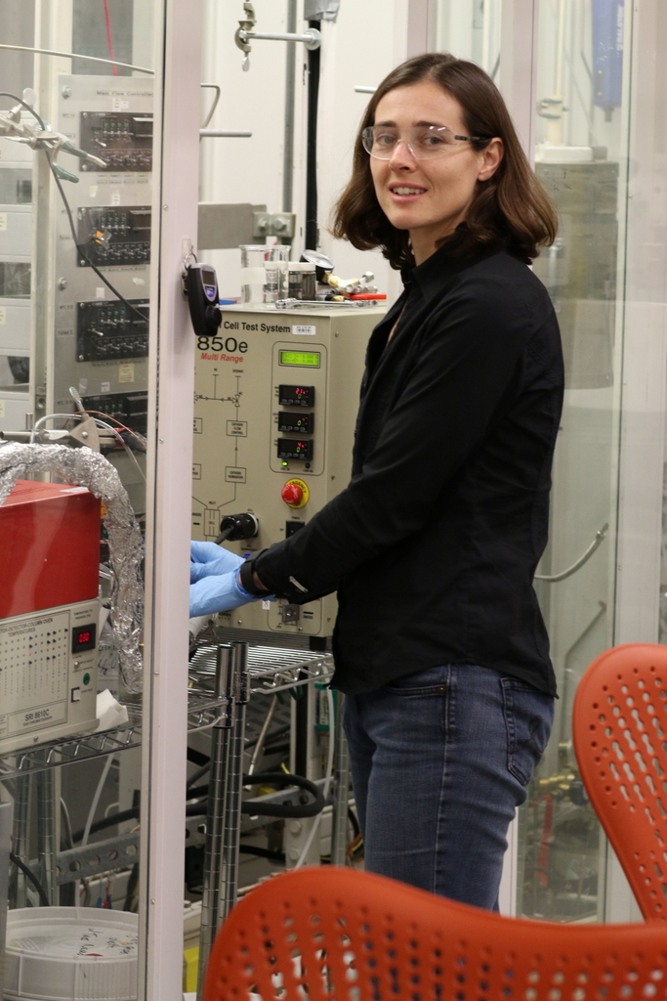

Notes:
Reference myself and Kendra, we added Nicholas

Slide 6
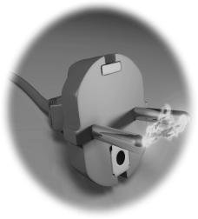
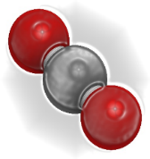
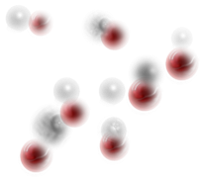
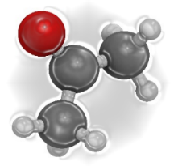
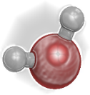


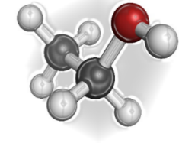
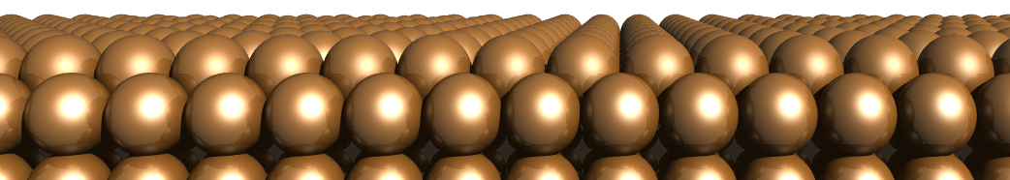
CO₂+ water
Chemicals and Fuels
Notes:
Land Give it more attention

Slide 7
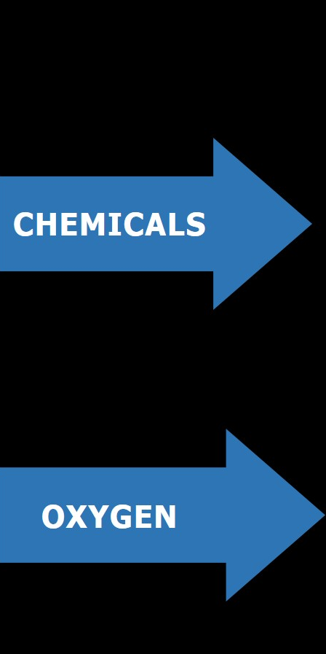
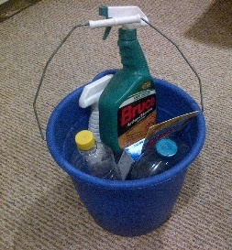
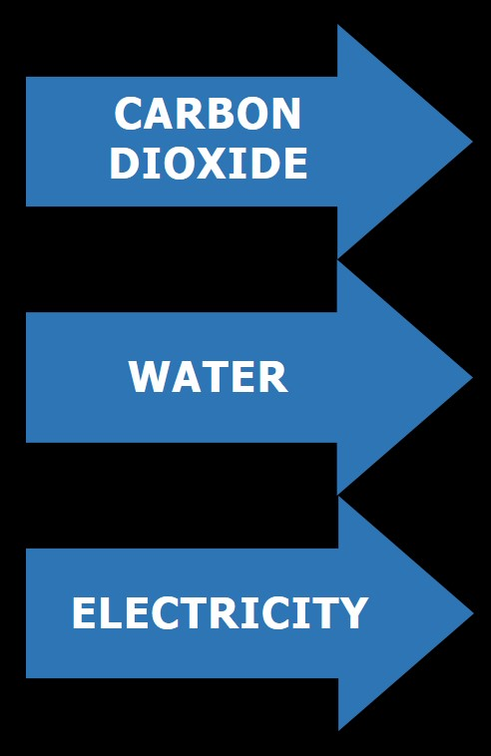
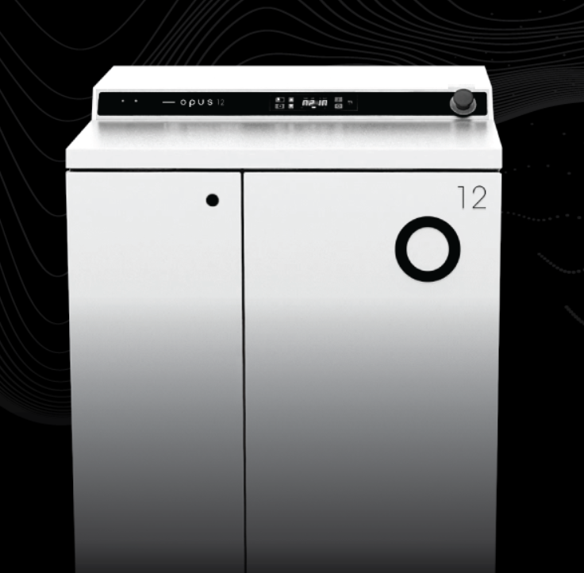
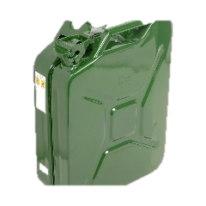
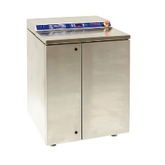
Carbon Dioxide
Chemicals
water
Oxygen
Electricity
75% energy efficiency
PEM electrolysis
Notes:
Prototype: Image courtesy of Steve Wedman, have permission to use.
Bucket of stuff: By Thekohser - Own work, CC BY-SA 3.0, https://commons.wikimedia.org/w/index.php?curid=28260475
Plastic bottles: http://www.publicdomainpictures.net/view-image.php?image=112756&picture=plastic-bottles
Solar panel: https://pixabay.com/en/solar-panel-sun-electricity-energy-1393880/
Fuel: http://www.toolstation.com/shop/Automotive/d60/Automotive+Safety+%26+Security/sd3190/Jerry+Can/p68414
Smoke Stack: https://www.flickr.com/photos/66770481@N02/6741179149

Slide 8
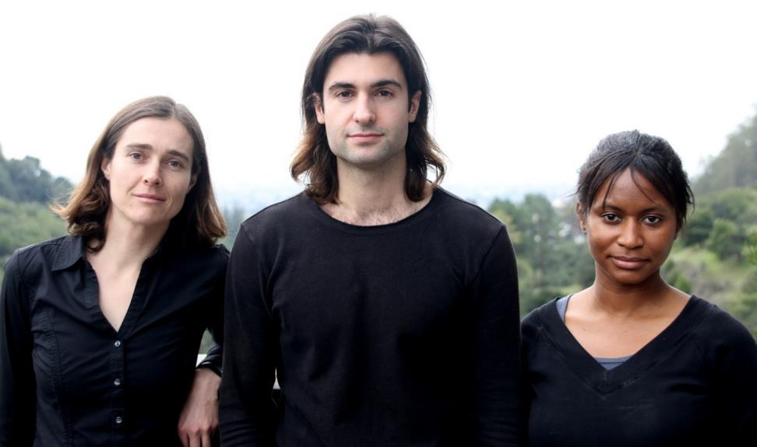

Slide 9
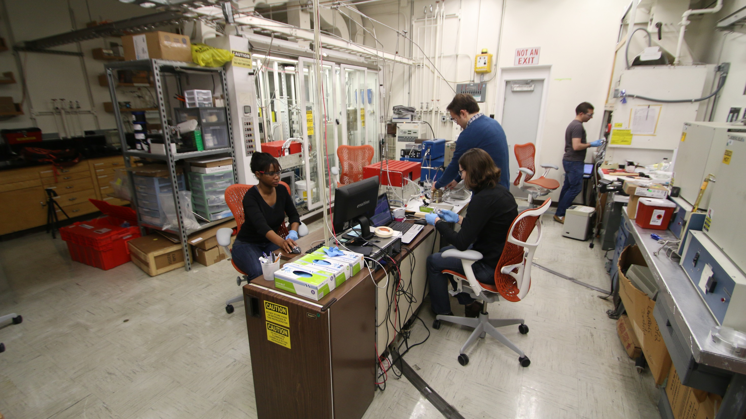
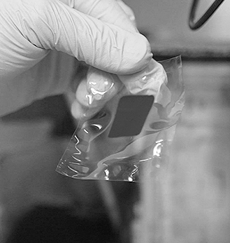
Notes:
Added Nicholas
Two years ago we spunout into a company We have moved out of the lab

Slide 10
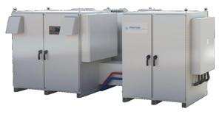
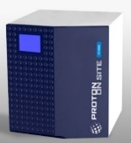
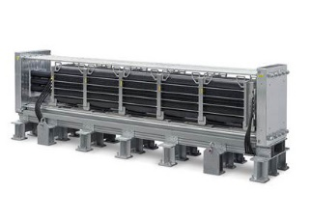
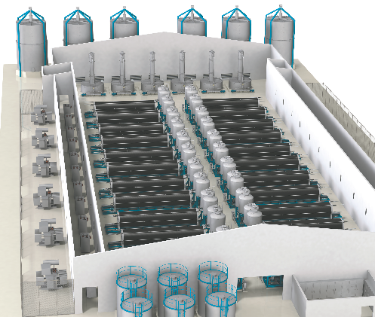
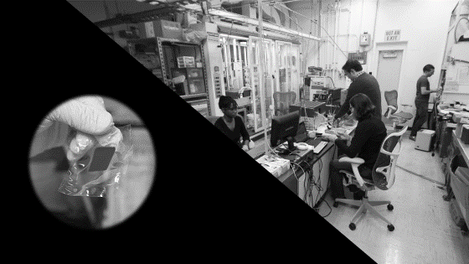
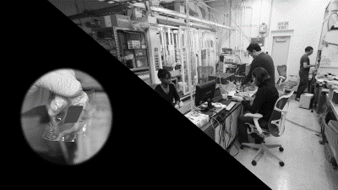
1
2
3
tabletop
lab
commercial
100 - 500 W
2 - 10 kW
50 - 250 kW
4
5
Industrial
Plant
1-2 MW
5-100 MW
Notes:
Could just say that is the size of our dishwasher
It would be about 37, 000 tres at the larger scale

Slide 11
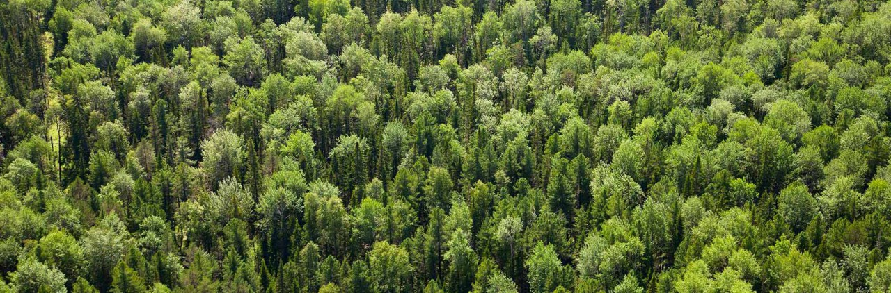
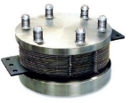
http://tree-nation.org/
700 trees...in our first product
Notes:
Land -- Trees in the palm of our hand

Slide 12
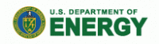










Step-by-Step: Financing our record-setting prototype
Major investors
Federal and state grants
commercial projects
manufacturing partner
Incubators & accelerators
Notes:
We have achieved significant traction with this innovation, winning grants from DOE, NSF, ARPA-e, NASA, and California Energy Commission. Shell and SoCalGas (the nation’s largest natural gas utility) have given us commercial feasibility funding. We have a manufacturing partnership with the world leader in PEM manufacturing. They will manufacture the hardware, and we will provide the new internal component. We recently closed an oversubscribed Series Seed financing with deep tech VCs from Silicon Valley and mission-aligned family offices from around the U.S.
We were selected as one of six companies in the country to be incubated in the first cohort of Cyclotron Road, a DOE-funded program that gives us free access to facilities and equipment at LBNL. We have participated in a number of highly selective accelerator programs, including StartX (top 5% of Stanford startups) and Elemental Excelerator.
We were the winners of the 2015 Department of Energy Transformational Idea Award (FLOW), the 2016 Forbes $400,000 Change the World Competition, and the 2017 Roddenberry Foundation $400,000 Bold Solutions for a Better Future competition.

Slide 13
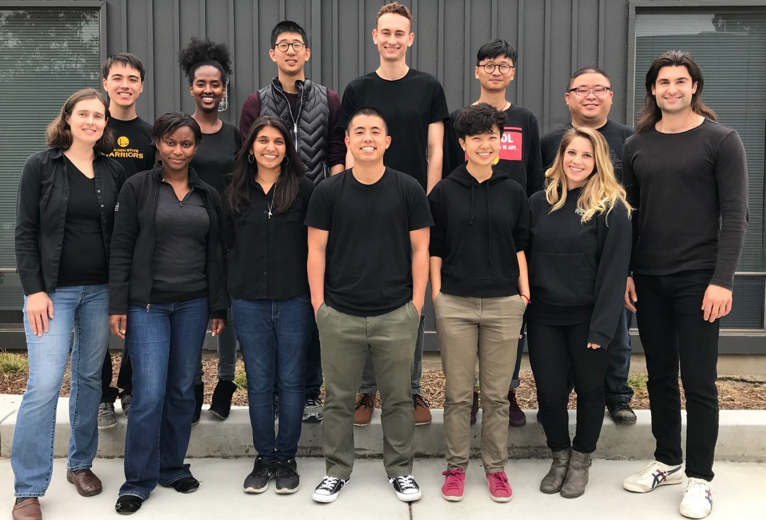
Team: Uniquely positioned to bring this product to market.

Slide 14
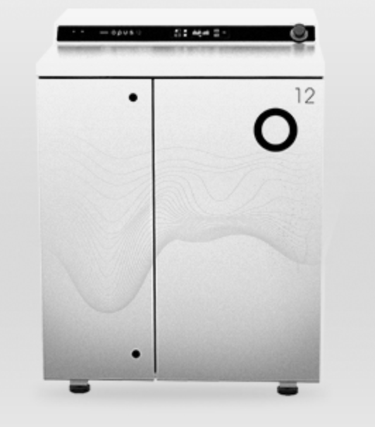
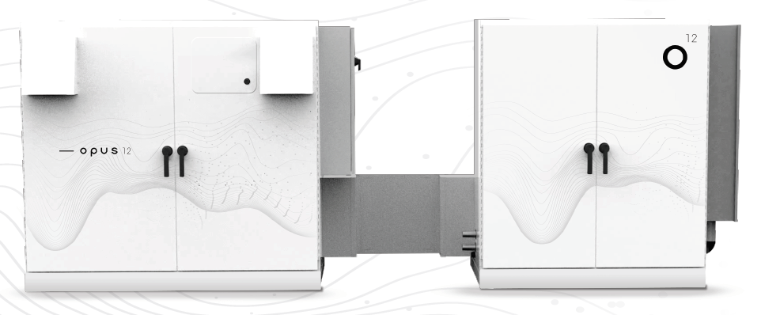
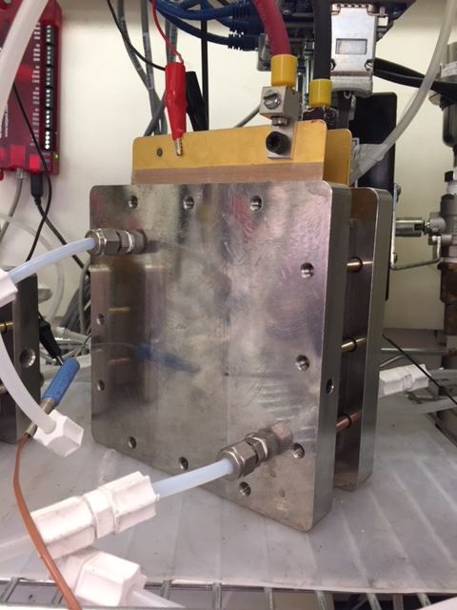
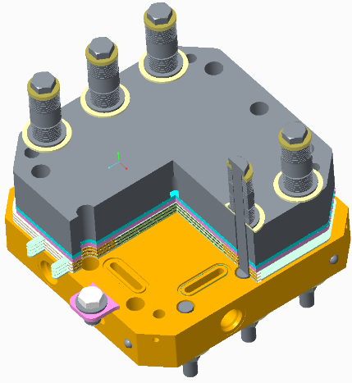
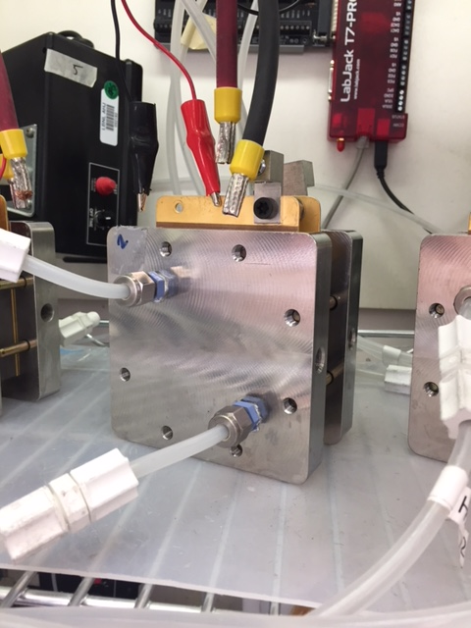


Roadmap to commercialization
25cm²
~5 kW CO₂
Electrolyzer
Scale up to MW systems
100cm²
Stack
Hardware

Slide 15













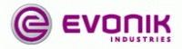
Platform technology: we will roll out new molecules and reactor sizes over time
Global Market
($ Billions):
Molecule:
5 kW
>100 kW
>1 MW
>50 MW
CO₂ impact¹ (Million tons)
Carbon monoxide
$40 B
266 M
First product
Methane (biogas)
$20 B¹
137 M
>150 MW
Ethylene
$126 B
748 M
>150 MW
Ethanol
$49 B
196 M
Other (e.g., n-propanol)
$56 B
68 M
$285 B
1,250 M

Slide 16
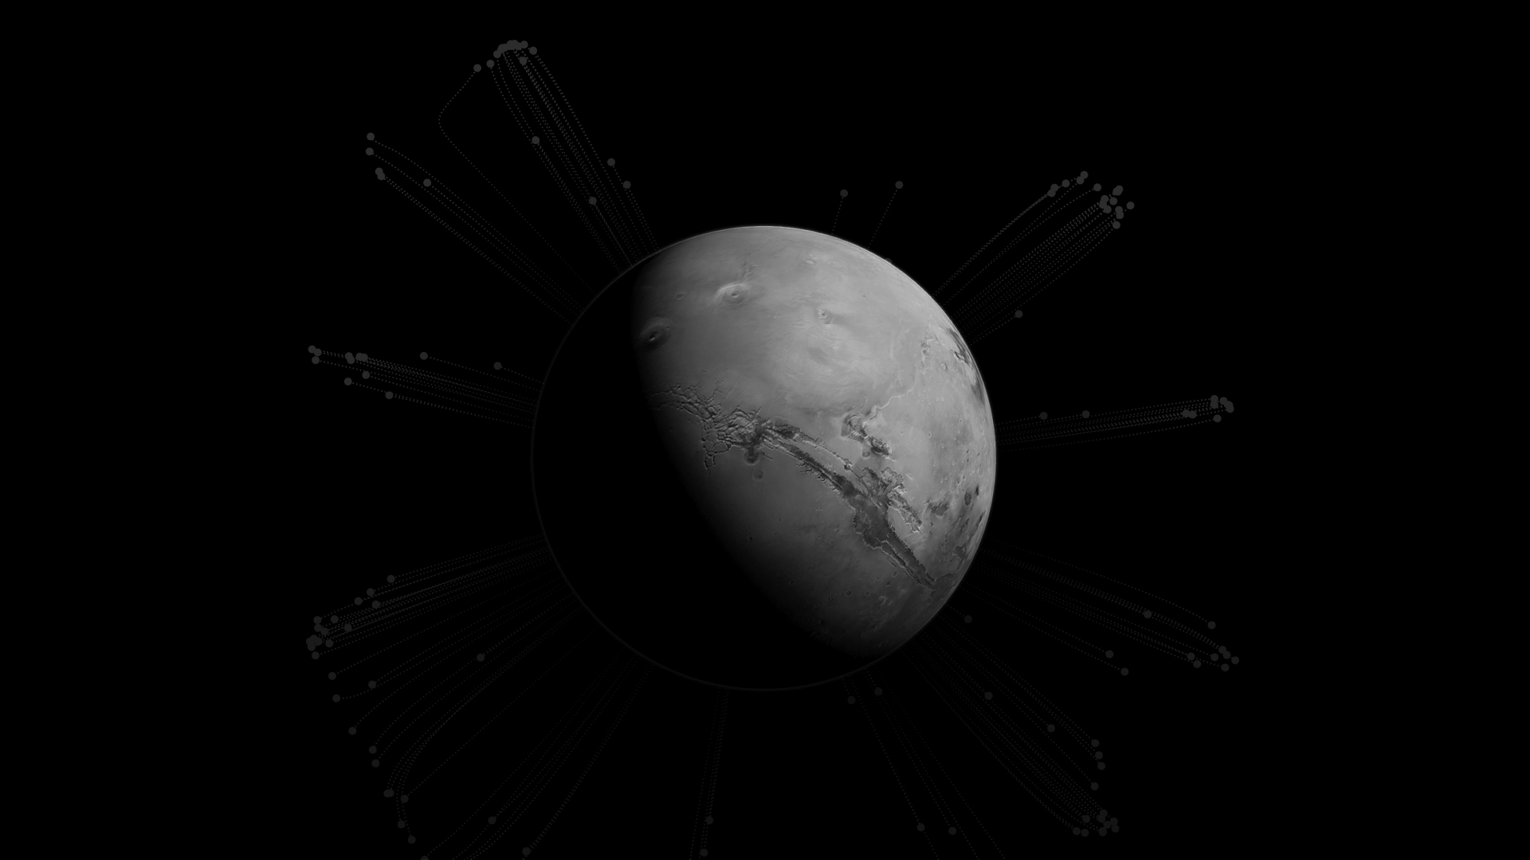
CO₂ conversion would be a critical
component of establishing a colony on Mars.
Rocket fuel, tools, materials, and oxygen – all synthesized from CO₂ into the Martian atmosphere
Confidential - prepared for Dolby | 6

Slide 17
Let’s rewrite the story of waste CO₂

