Slide 1
Fighting Air Inequality
Through Open Data and Communities
Christa Hasenkopf, PhD
CEO/Co-Founder of OpenAQ
openaq.org
@Open_AQ

Slide 2
Air Inequality
1 out of 8 deaths in the world is due to air pollution
(WHO, 2014)

Slide 3
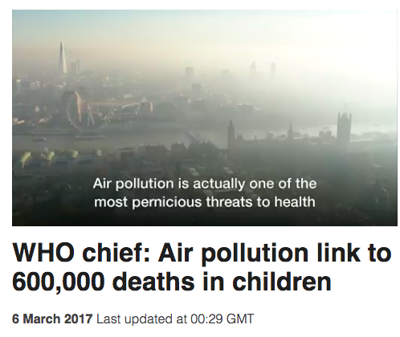
Air Inequality
1 out of 8 deaths in the world is due to air pollution
(WHO, 2014)

Slide 4
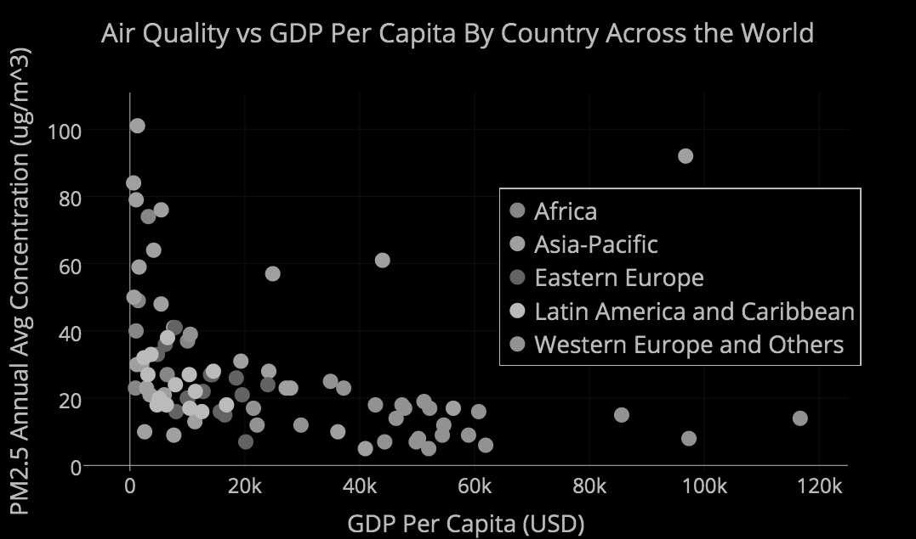
Air Inequality
Yearly Smoke and Fine Dust Pollution
WHO 2016 OAP Database + World Bank Data

Slide 5
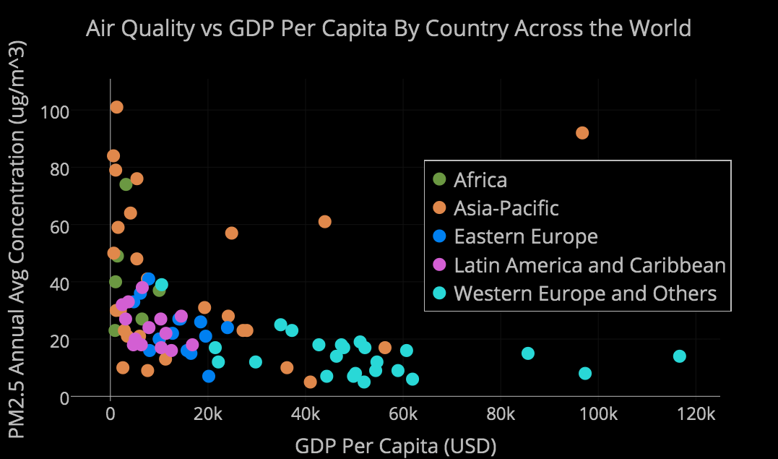
Air Inequality
Yearly Smoke and Fine Dust Pollution
WHO 2016 OAP Database + World Bank Data

Slide 6
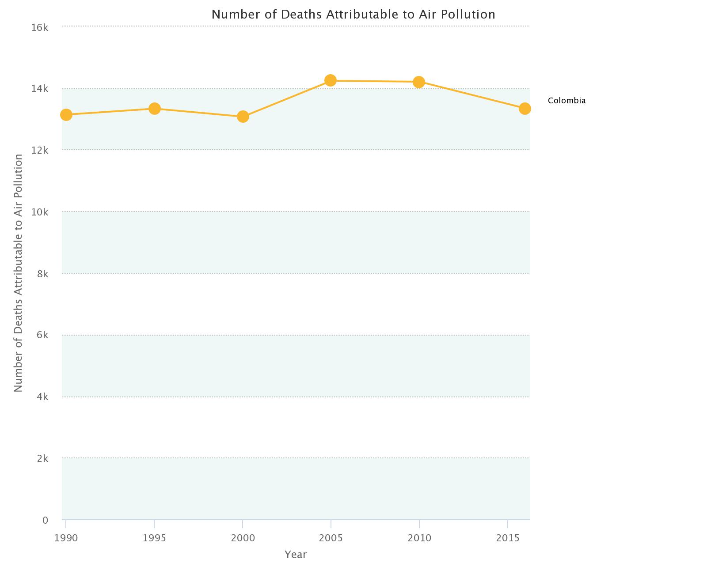
14k
Number of Deaths Due to Air Pollution
8k
~14,000 deaths each year from air pollution in Colombia
2k
Source: stateofglobalair.org
1990
Year
2015

Slide 7
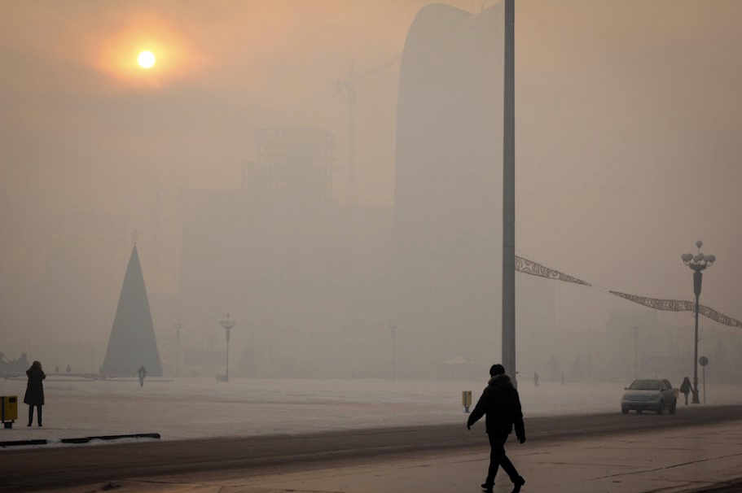
Ulaanbaatar, Mongolia
Photo Credit: Lauren Knapp

Slide 8
Good News!
photographyblogger.net

Slide 9
Change =
Political Will
+ A Plan
Bangkok
London
Beijing
Figures from wikipedia.org

Slide 10
Change =
Political Will
+ A Plan
Bangkok
London
Beijing
Figures from wikipedia.org
Both require multi-sectoral community + connected open data

Slide 11
Change =
Political Will
+ A Plan
Bangkok
London
Beijing
Figures from wikipedia.org
Both require multi-sectoral community + connected open data

Slide 12
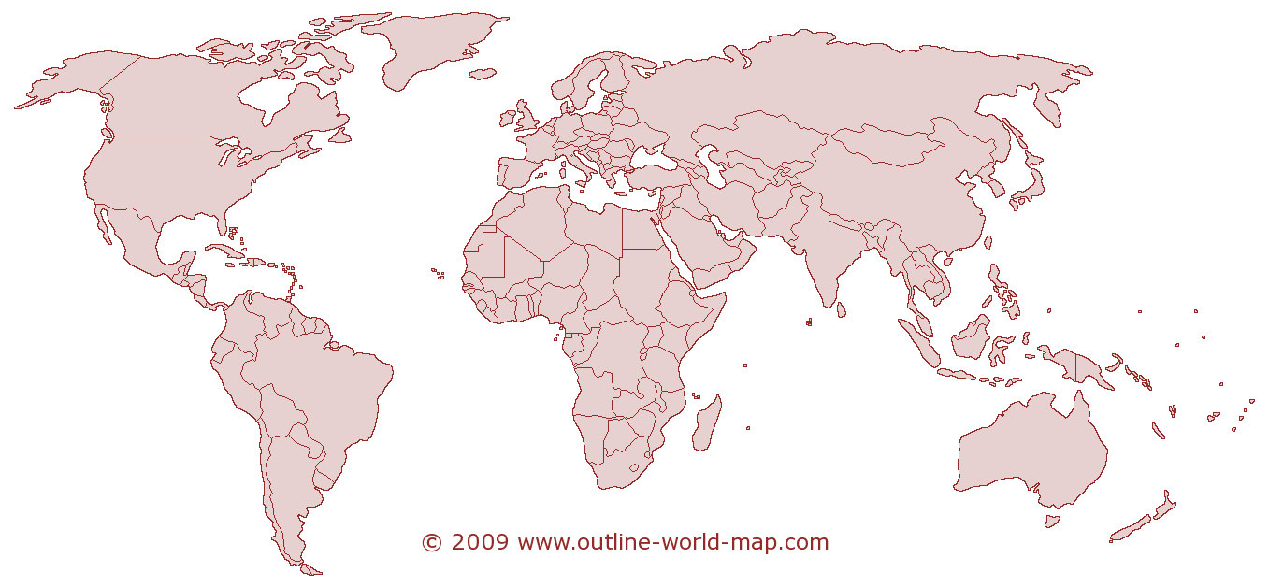
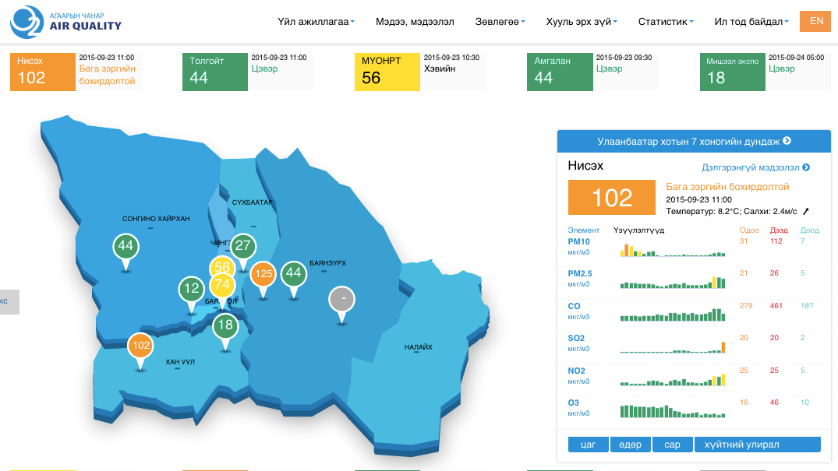
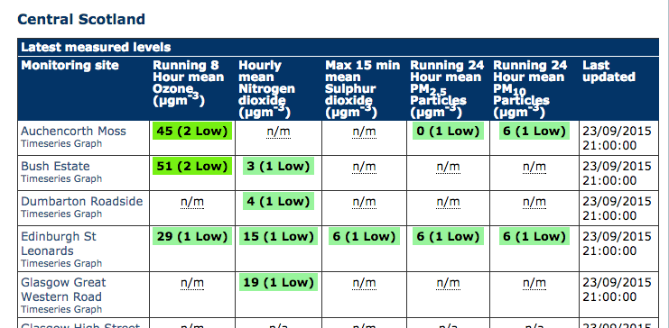
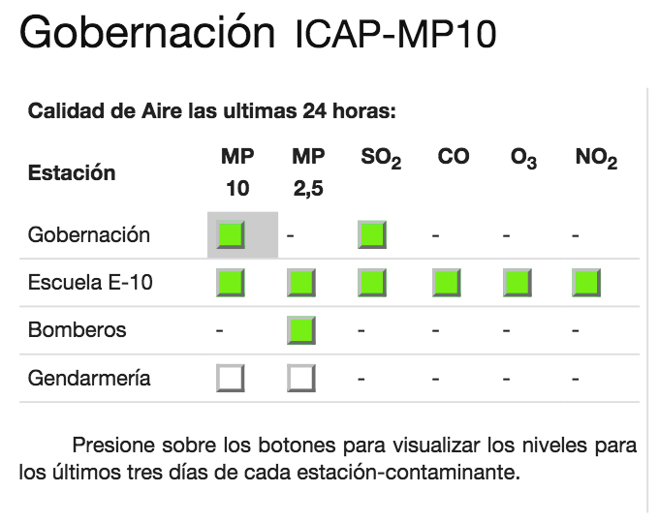
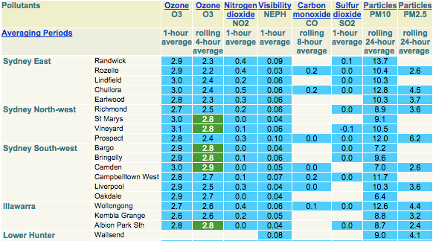
AQ Open Data Landscape Landscape
real-time, government
~75 Countries
5-8 million data points per day
Disparate formats, some temporarily exist
Notes:
Different quality issues

Slide 13
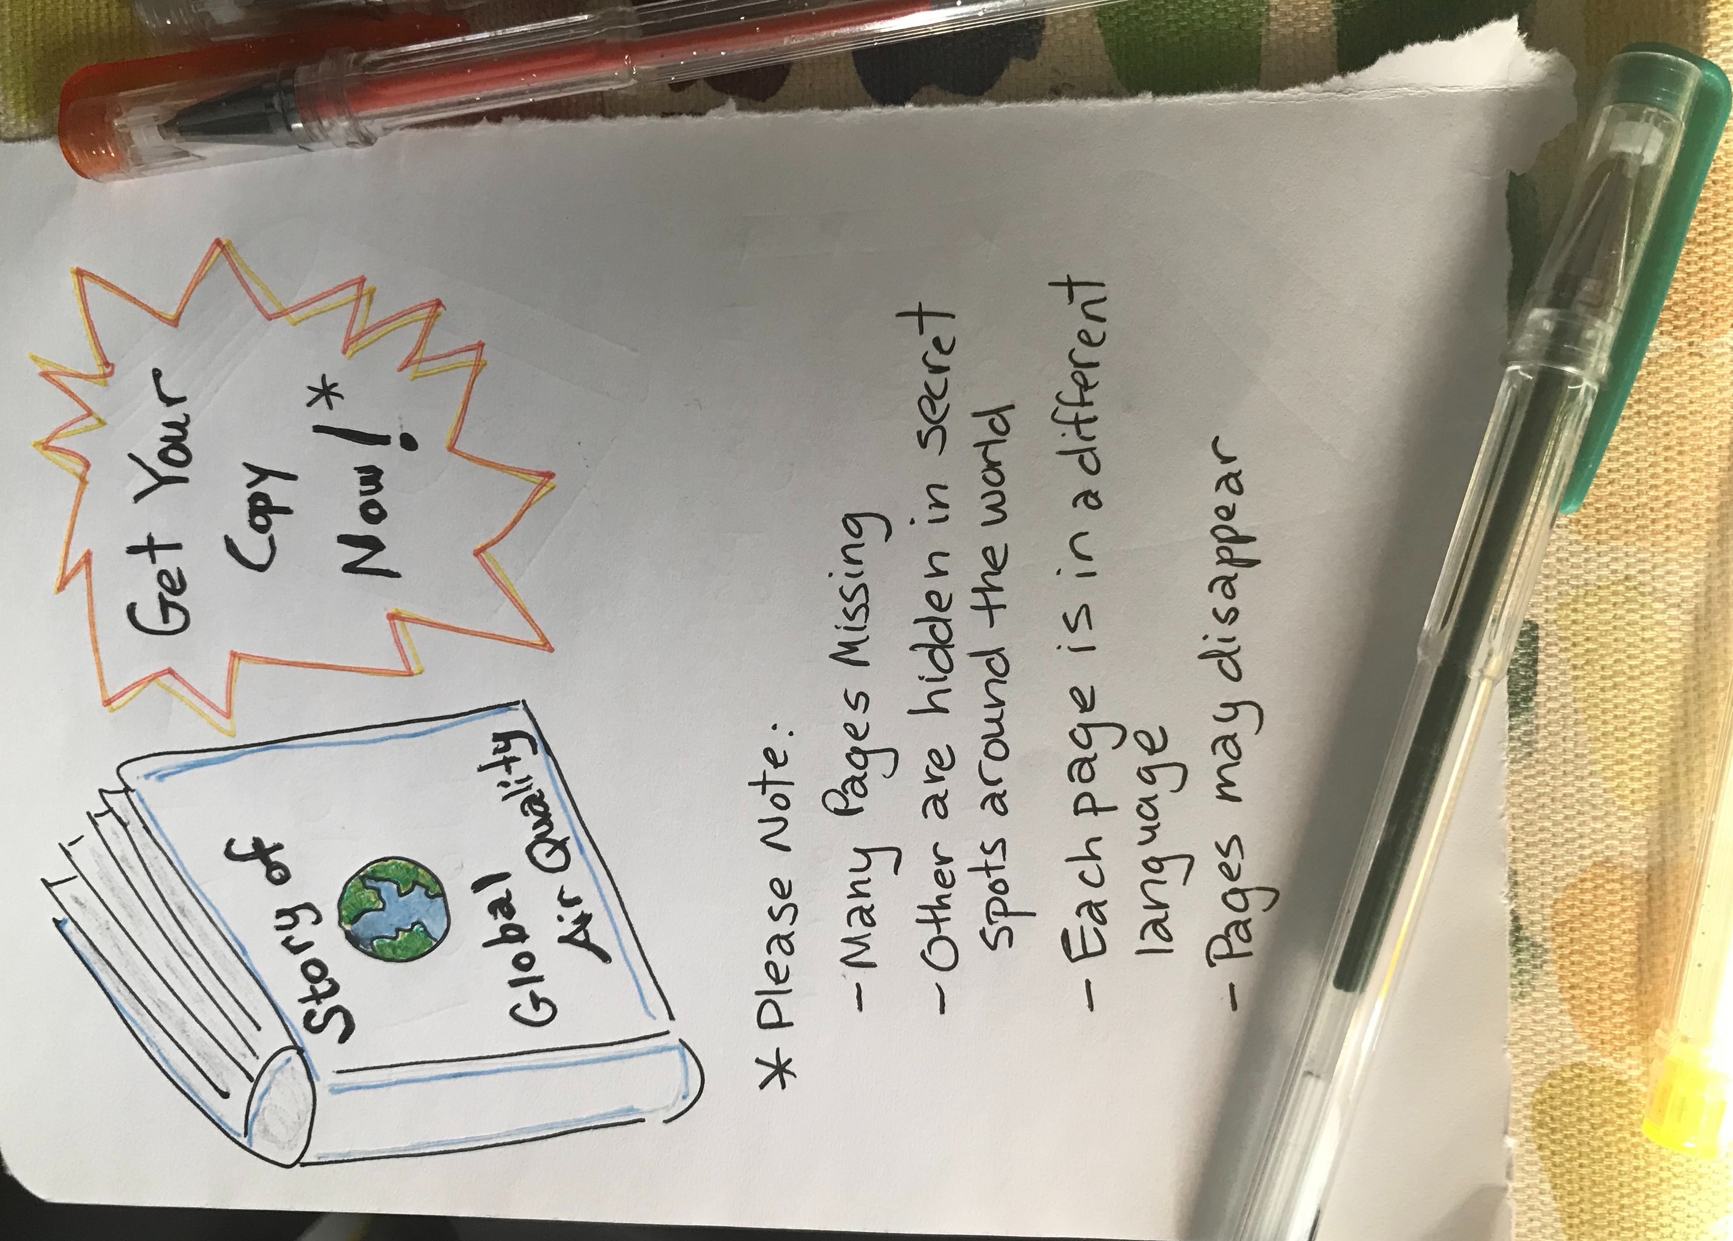

Slide 14
Much of our civilization’s longest and most consistently measured environmental data is unconnected and therefore its potential is massively under-realized.

Slide 15
Connecting Open Data
Media
Government/Policy
Climate Change + Public Health Research
Disparate AQ Open Data
Collected Across
the World
Private Sector
Educational Activities
Notes:
So what we see is all of this disparate, messy public data, and all of these sectors that are just itching for access to do impactulf things, like data-driven journalism, low-cost sensor calibrations, educational activities, and public health research. There are specific examples for each one of these we could talk about – I won’t, but for instance: A really startling fact: 7/10.
So the gap is making these data available. And that’s where OpenAQ comes in.

Slide 16
Connecting Open Data
Media
Government/Policy
Climate Change + Public Health Research
Open,
Transparent, Accessible
Universal Data Layer
Disparate AQ Open Data
Collected Across
the World
Private Sector
Educational Activities
OpenAQ
Notes:
So what we see is all of this disparate, messy public data, and all of these sectors that are just itching for access to do impactulf things, like data-driven journalism, low-cost sensor calibrations, educational activities, and public health research. There are specific examples for each one of these we could talk about – I won’t, but for instance: A really startling fact: 7/10.
So the gap is making these data available. And that’s where OpenAQ comes in.

Slide 17
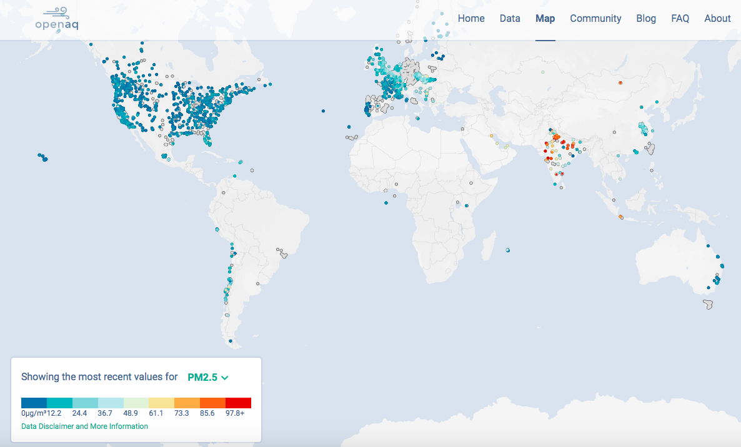
Open and free API to >250,000,000 data points from 67 countries’ governments
openaq.org
Notes:
To demo after this slide

Slide 18
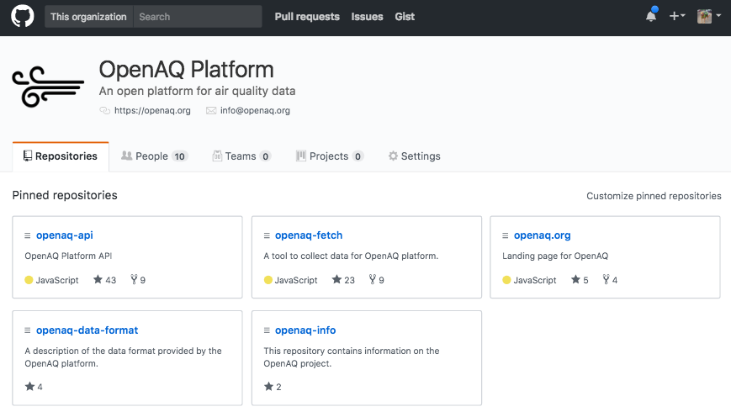
Grassroots Effort
github.com/openaq

Slide 19
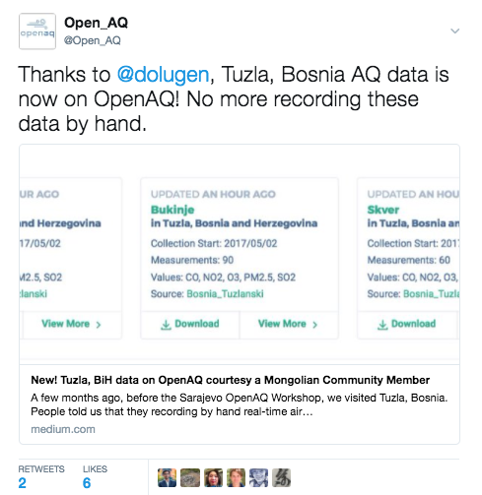
Grassroots Effort
github.com/openaq

Slide 20
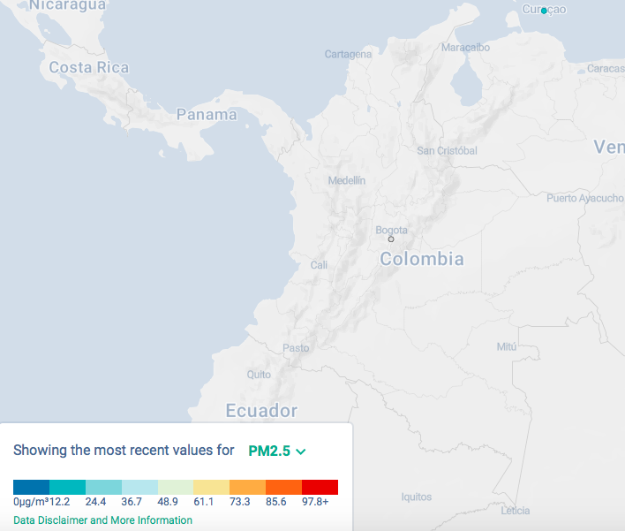
An Open Invitation
How can we add to Colombia’s part of the global air quality story?
A shout out to great folks at Colombia’s IDEAM who are working with us on historical data.

Slide 21
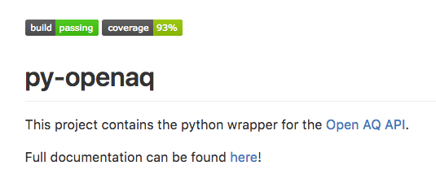
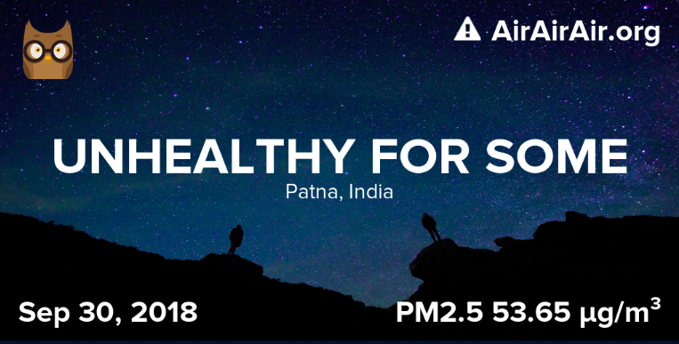
Findable, Universally-Formatted Data
Enable Ecosystems
Open Source
Tools+Apps

Slide 22
Findable, Universally-Formatted Data
Enable Ecosystems
Open Source
Tools+Apps
Future Scenarios
Pommier et al.. (2018)

Slide 23
Findable, Universally-Formatted Data
Enable Ecosystems
Open Source
Tools+Apps
Satellites + Low-Cost Sensors
Future Scenarios
Picture courtesy NASA
Pommier et al.. (2018)

Slide 24
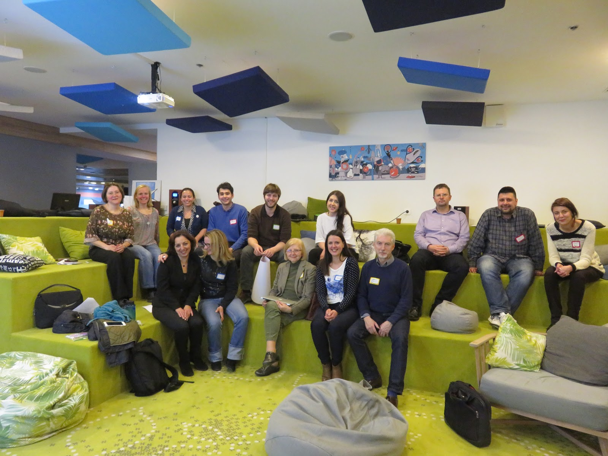
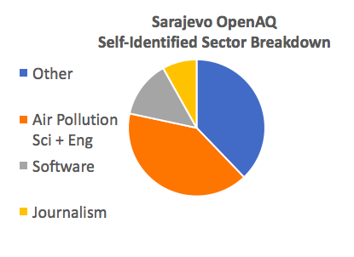
Convening Around AQ Open Data: Sarajevo 2017: Part 1

Slide 25
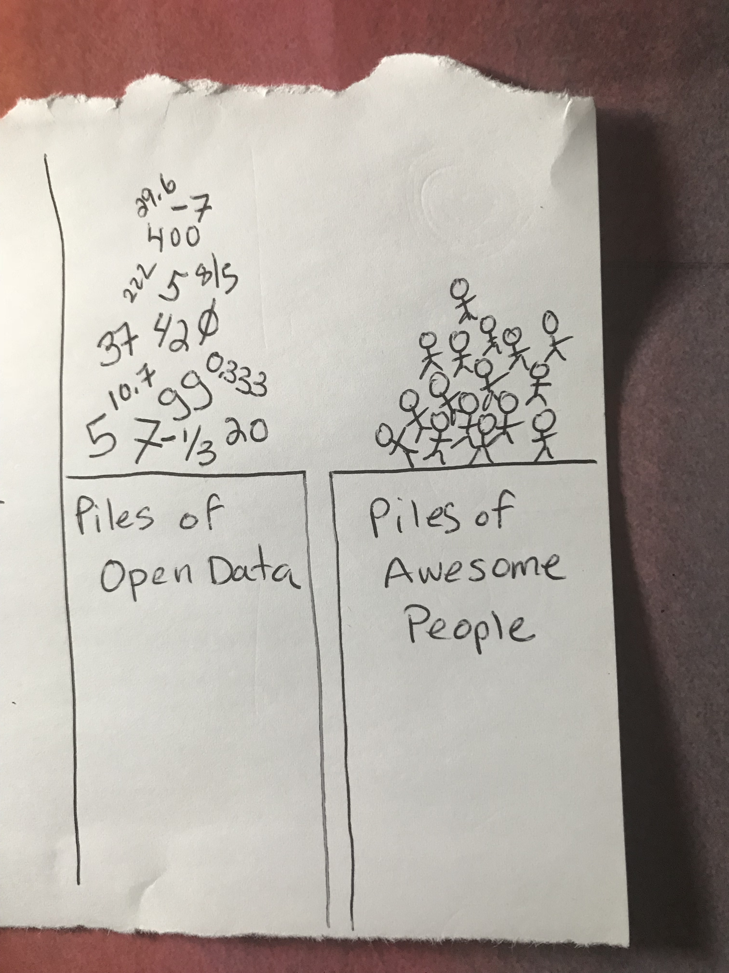
As a last note:

Slide 26
Tiny bridge, big impact!
As a last note:

Slide 27
Tiny bridge, big impact!
As a last note:
There are a endless climate change projects to be done in connecting existing open data, opening up more data, and building on top of it.
What will you do?

Slide 28
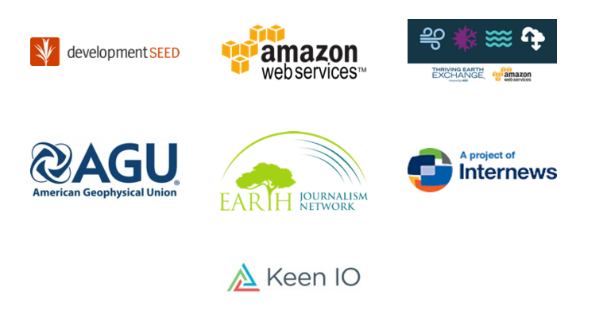
Thank-you!
Contact us: openaq.org | christa@openaq.org | @open_aq
Join us on Slack! https://openaq-slackin.herokuapp.com/
Thanks to Low Carbon City, the OpenAQ Community, and our other partners & sponsors:

