Slide 1
The Digital Sustainability Movement

Slide 2
Internet

Slide 5
Cost of the Internet

Slide 9
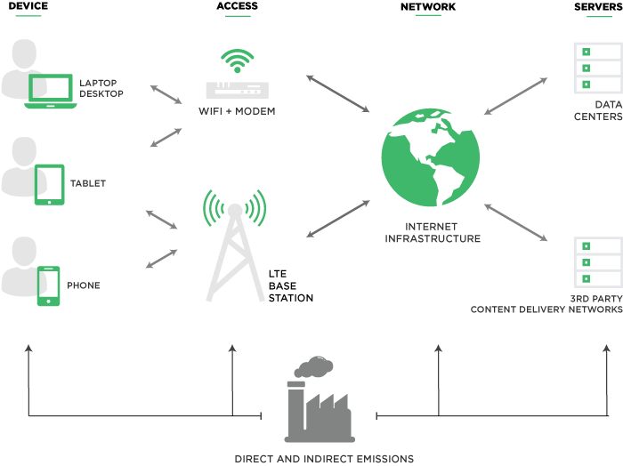
How the cloud
Works

Slide 12
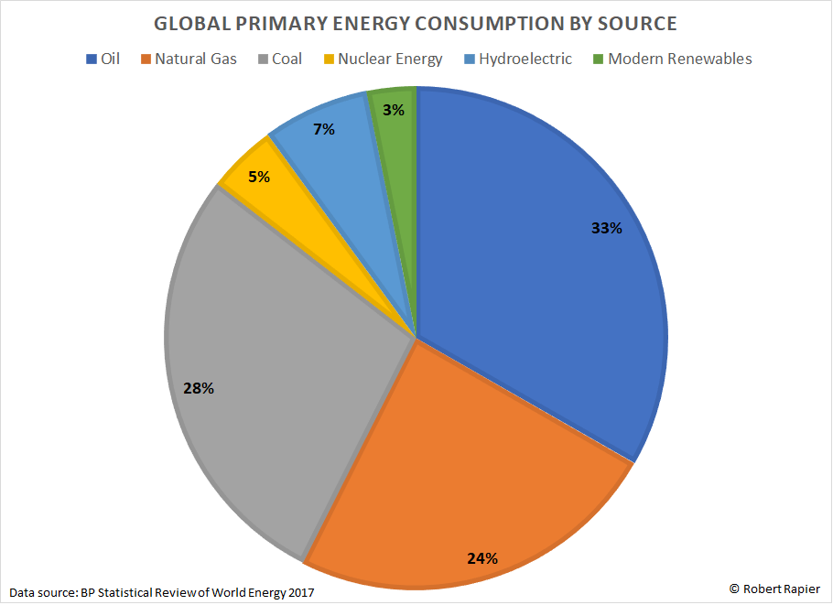

Slide 14
Donald Trump
Total Tweets = 40,000+
Total CO2 Output = 370 kg
Equivalent to =

Slide 16
Netflix
Length of show = 2 hours
Total energy used = 300 kWh
Equivalent to =

Slide 18
Jevons Paradox
“Occurs when technological progress increases the efficiency with which a resource is used, lowering the price of said resource, but the rate of consumption of that resource rises due to increasing demand”.

Slide 19
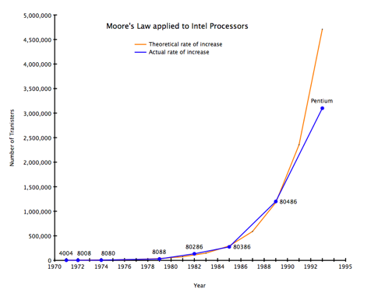
Moore’s Law
Overall processing power for computers will double every
two years.

Slide 20
The internets
leading website sustainability certification

